Slide 1
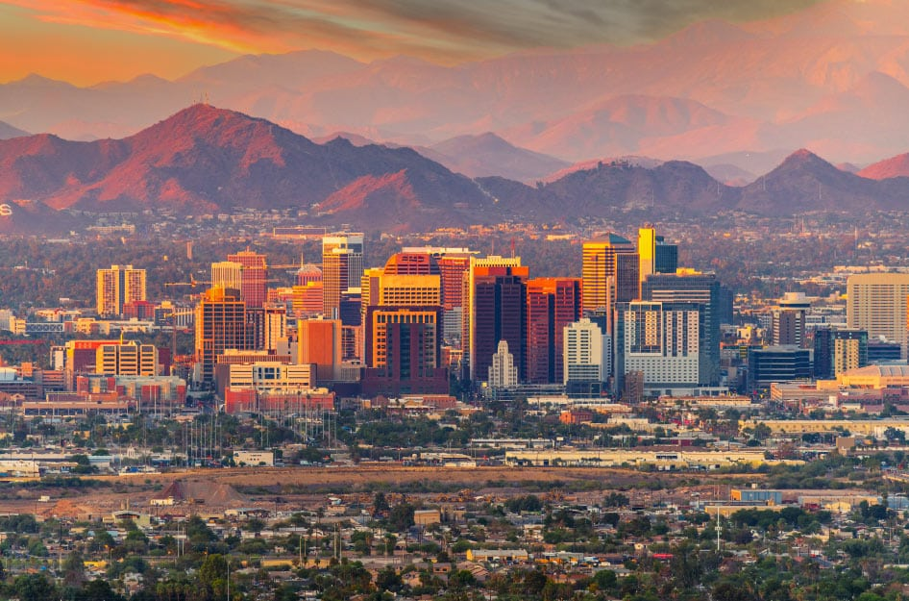
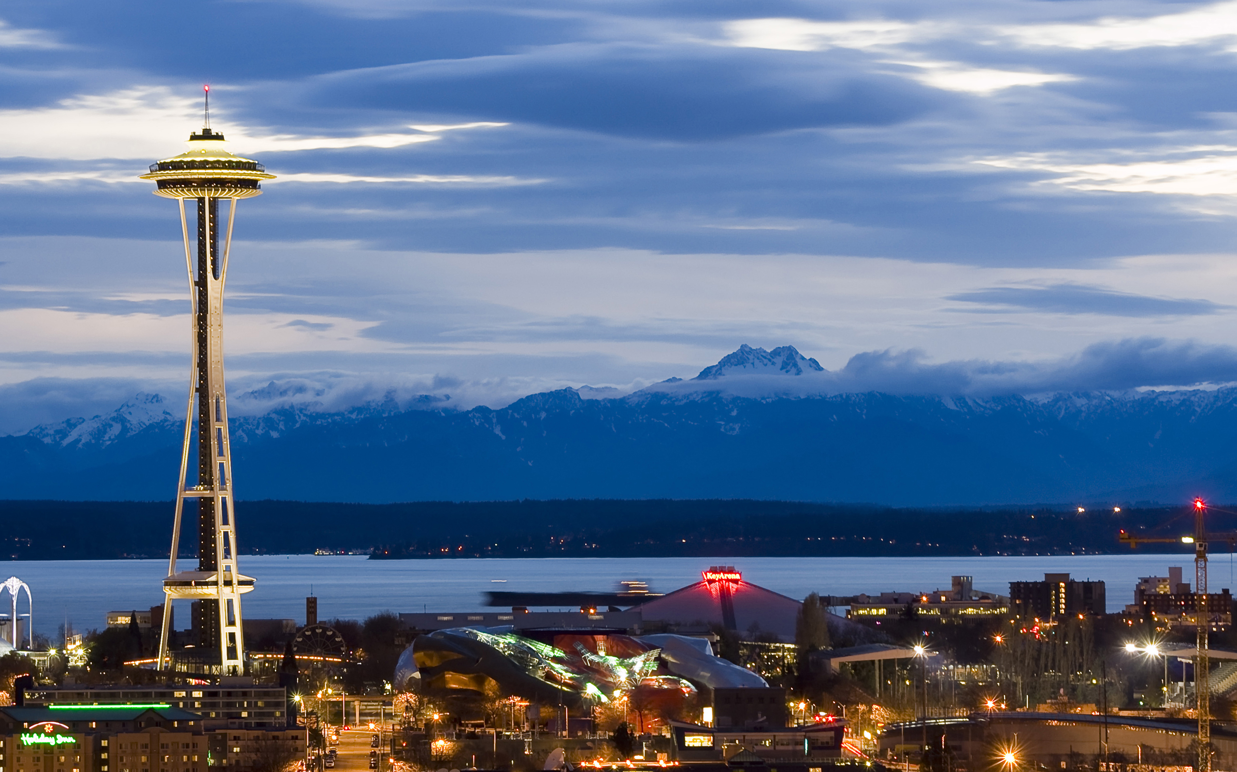
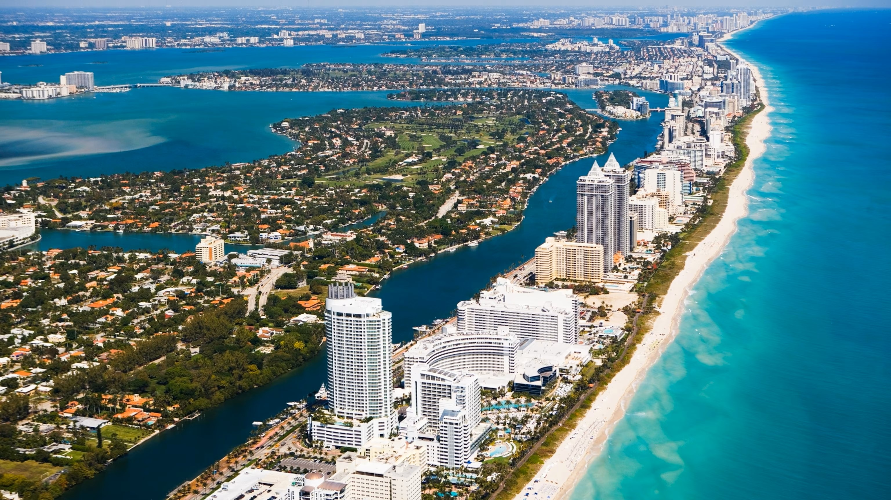
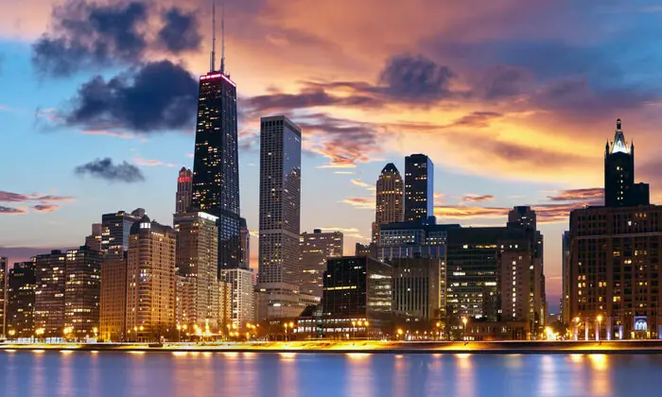
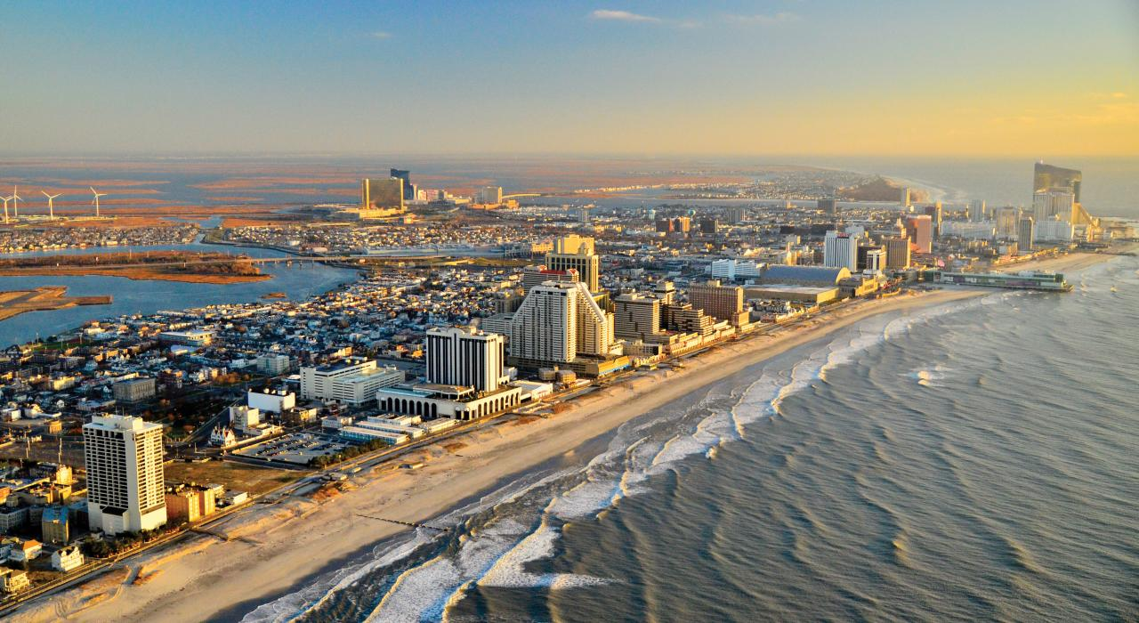
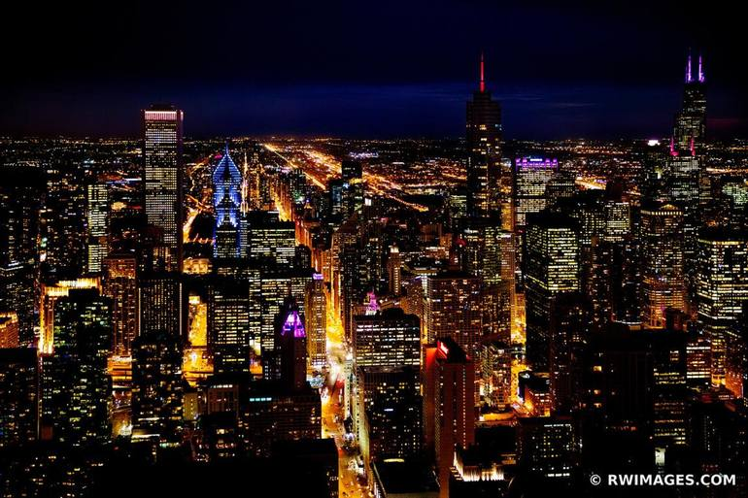
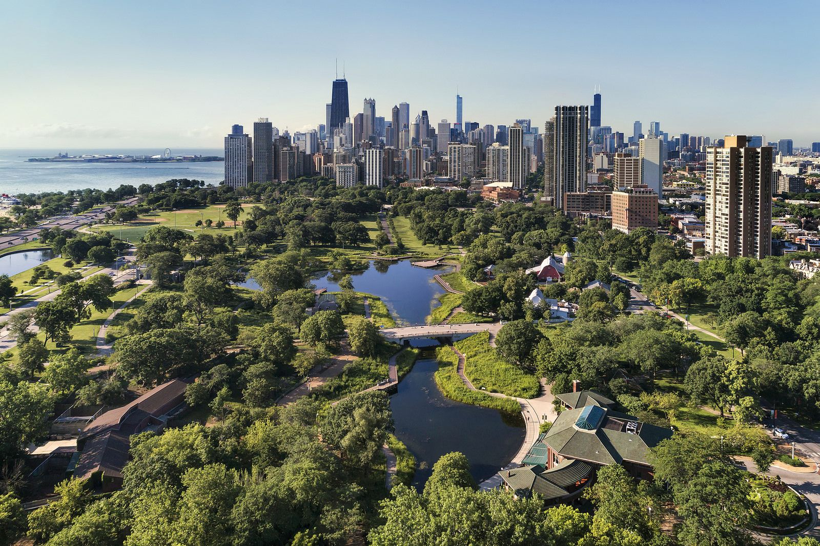

Image/link
Image/link
Image/link
Image/link
Image/link
Phoenix, AZ
Seattle, WA
Miami, FL
Chicago, IL
Atlantic City, NJ
Chicago, IL, also known as the "Windy City," is a vibrant and diverse metropolis located on the shores of Lake Michigan. It is renowned for its stunning architecture, world-class museums, iconic skyline, and rich cultural heritage. As the third-largest city in the United States, Chicago offers a bustling urban environment combined with a friendly Midwestern charm.
With its distinct seasons, Chicago experiences hot summers and cold winters, often accompanied by snowfall. The city's location on Lake Michigan creates a unique microclimate, influencing its weather patterns.
Images of city
Temperature: 59°F
Hi67°/Lo58°
Precipitation: 15% Humidity: 92%
Wind: 6 mph
Backround will change depending on time Light Light blue/ Orange/Dark blue
Images of city
Images of food

Slide 2
Select a City
↓
Image/link
Image/link
Image/link
Image/link
Temperature: 59°F
Hi67°/Lo58°
Precipitation: 15% Humidity: 92%
Wind: 6 mph
Image/link
Temperature: 59°F
Hi67°/Lo58°
Precipitation: 15% Humidity: 92%
Wind: 6 mph
Chicago, IL, also known as the "Windy City," is a vibrant and diverse metropolis located on the shores of Lake Michigan. It is renowned for its stunning architecture, world-class museums, iconic skyline, and rich cultural heritage. As the third-largest city in the United States, Chicago offers a bustling urban environment combined with a ….
Backround will change depending on time Light Light blue/ Orange/Dark blue
Show more/less button
Chicago, IL, also known as the "Windy City," is a vibrant and diverse metropolis located on the shores of Lake Michigan. It is renowned for its stunning architecture, world-class museums, iconic skyline, and rich cultural heritage. As the third-largest city in the United States, Chicago offers a bustling urban environment co…
Images of night city
Show more/less button
Images of enviroment
Images of city
Images of city
Images of food
Images of food

